Slide 1


Planned changes to registration of data concerning real property
Surveyor Vibeke Stærdahl Nielsen
Notes:
Frontpage

Slide 2
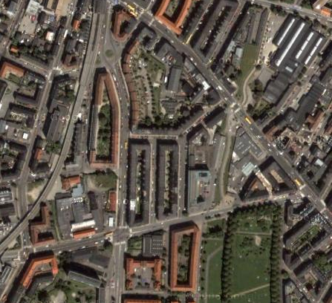

Two authorities
Danish Geodata Agency
  Ministry of the Environment
The Land Registry
  Ministry of Justice
Location
Rights
Restrictions
Responsibilities
Notes:
To somehow make it understandable for you, I have to tell you – the next 4 slides – very shortly how the Cadaster and Landbook, that in Denmark, vi have a Devided system.
In two ministries
Geographical element – cadastral map and register
Landbook

Slide 3
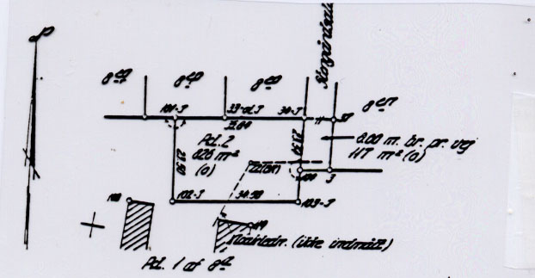
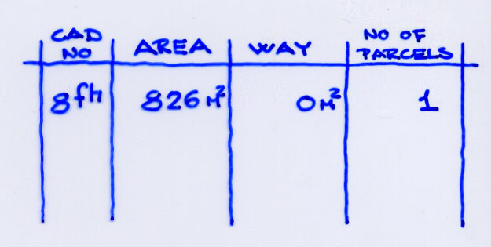
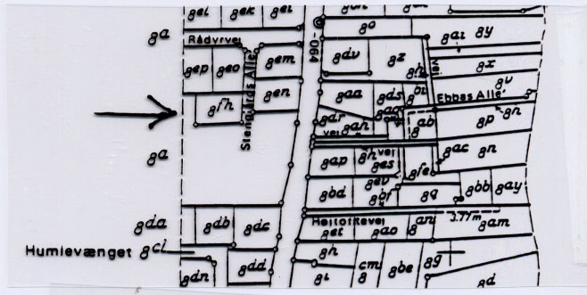
The Cadastre – 3 main elements
The Cadastral register identifies the land parcels by number and area + informs on other information
The cadastral measurements identify the position of the property boundaries
The Cadastral map geographically identifies the land parcels
Notes:
A Closer look on the cadastre
Consists of three main elements
Register
Map
Measurements

Slide 4
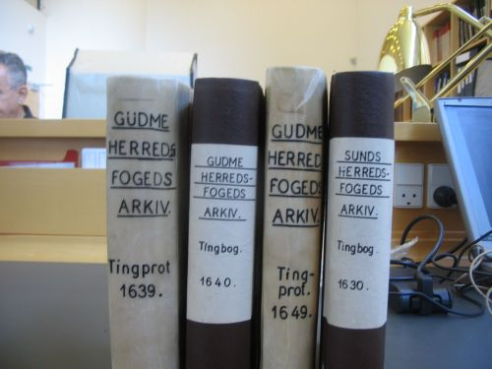

The Land Register
Each property have a file that contains four main sources of information
  General information
  Title information
  Easements
  Mortgages
Books in the past – today fully digital system
Notes:
Ministry of Justice is as mentioned responsible for the maintenance of the Land book
From 2009 we had a digital landbook.

Slide 5

Historic oversight
of the Danish digitization of the cadastre
1986: The protocols/register are digitized
1997: The cadastral maps are digitized (along the way in the digitizing proces several mapping systems where implemented)
2005: MIA – digital updating from the surveyors
2008: MiniMaks – maps and register in the same system
2013: Historic cadastral cases are scanned and made available online
Notes:
To give you an idea of the digitization of the Cadastre.

Slide 6

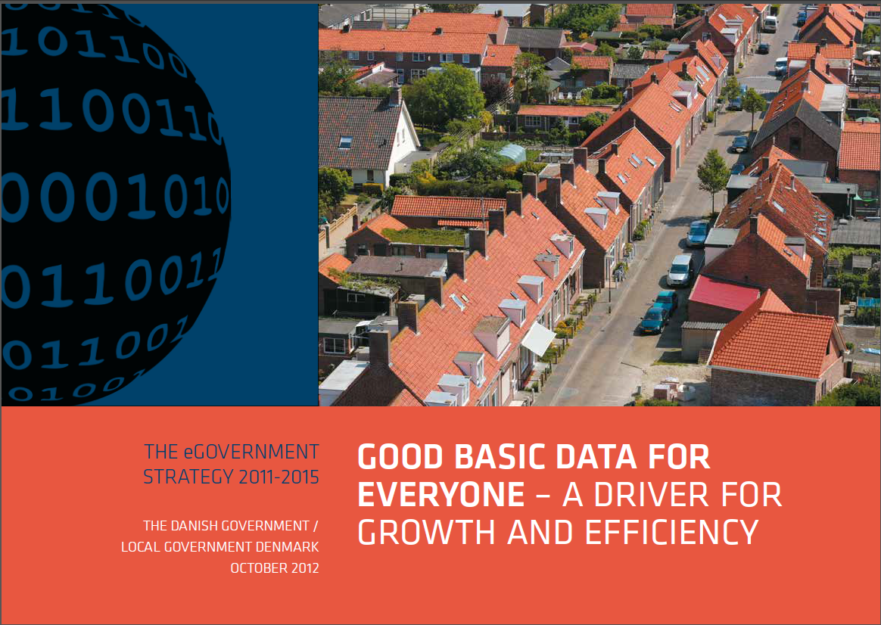
Spatial data initiatives - basic data packages
Open Governmentdata
Property
Addresses
Water
Distribution
…..
Effective property administration
and reuse of property data
SIDE 6
Notes:
Large values linked to privately owned property
Property used as security in the loan market (~ 3 x GDP)
Tax object with a significant contribution to the state budget ~ 5 billion Euro

Slide 7






The involved Parties
Ministry of Housing, Urban and Rural Affairs
Danish Geodata Agency – Ministry of the Environment
National Land Registry - Ministry of Justice
Local Government Denmark Interest group and member authority of Danish municipalities.
SKAT – Ministry of taxation
Agency for Digitization – Ministry of Finance
Notes:
Page with title and one column

Slide 8
The rationale for the Property Data Programme
Creating a more efficient work flow within the municipalities and the Geodata Agency
Reduced IT expenses for the development and operation of a new ‘shadow’- Municipal Property Register
Improvement in the quality of basic data: Consistent terminology Data Normalisation and Standardisation Unique Property Identifier
$
Notes:
Public sector benefits
No need for copy-registers
Simpler systems and thus lower cost for developments, maintenance and use
Fewer manual processes especially within the municipalities
More efficient cadastral system and cooperation between the private surveyors and the Danish Geodata Agency (Cadastre) + workflow with the municipalities
More efficient functioning private mortgage market
Improvement in the quality of basic data:

Slide 9

Contents of the Property Data Programme
Overall aims
Use the same property data model through out the basic data registers – Cadaster, Building, Ownership and Land Registry.
Basic registration of all types of property is done uniformly and collected in the cadaster
A new property owner ship register (actual ownership) is implemented
Buildings and addresses are linked to properties according to the data model
Property data will be available in a pre-registration phase
Basic data will be distributed through the Data Distributor

Slide 10
What will happen?
    All types of real properties are registered within the cadastre (also condeminiums and buildings and dwellings on leased parcels) One unique property identifier for all property types!
    Digitization of the workflow with the municipalities
    Registering properties in-the-making
    Implemented within the basic data programme – forming a coherent basic data framework distributed on the common public datadistribution channel ‘Datafordeleren’
Notes:
To give you an idea of the digitization of the Cadastre.

Slide 11
Future registrations in the Cadastre
All types of real property is to be registered in the same institution/database =the Cadastre – at the Danish Geodata Agency (GST).
Earlier registration (=access to pre-registration phase) to be introduced.
Parcels – are already registered at GST
Condominiums – are now registered at the National Land Registry
Buildings on leased parcels - are now registered at the National Land Registry and in the Municipal Property Register (ESR)
(Also possible to register buildings and technical objects off shore)
=> More efficient property administration through out the financial sector, municipalities, state authorities, chartered surveyors etc.
SIDE 11

Slide 12



Contents of the cadastre
ESR
Building on leased parcel
Landbook
Building on leased parcel
Condominiums
Cadaster
MAT
Parcels

Slide 13
Contents of the cadastre after changes
ESR
Building on leased parcel
Landbook
Building on leased parcel
Condominiums
Cadaster
MAT
Parcels
Building on leased parcel
Condominiums

Slide 14
Conceptual model of extended cadastral system
Surveyor client
Authority client
GST client
BBR client
Private surveyor applications
Reporting and consultation with authorities
Basic cadaster data register
Intergration
Administration
Users
Addresses
BBR data
Databases
Data Distributor

Slide 15
Main delieverables for the cadastral project
Expand the existing it-system for cadastral updating so it can handle all types of real property
Develop system/interface for application of changes to all types of properties to be used by the private land surveyors to up-load change-data
Develop solution for making property data available in pre-registration phase and as final property data through the Data Distributor
Migrate and consolidate data on condominiums and buildings on leased parcels from the Land Registry and the Municipal Property Register
Prepare new legislation etc.
SIDE 15

Slide 16
Tentative implementation plan
2014 Q1
Q2
Q3
Q4
2015
Q1
Q2
Q3
Q4
2016
Q1
Q2
Q3
Q4
Specification of system
Tender for service provider
Development of the extended cadastral system
Implementation of the Property Data Program
Notes:
Page with title and one column

